Slide 1
BBC micro:bit v2 - Using the REPL
Steve Case

Slide 2
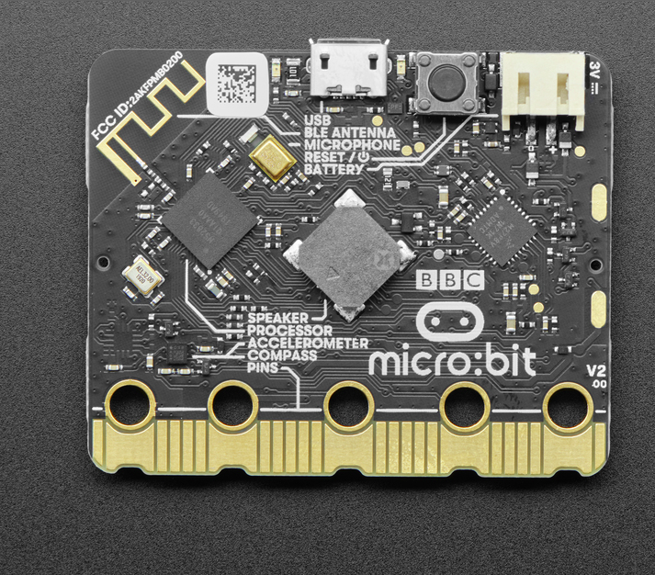
BBC micro:bit v2 Development Board

Slide 3
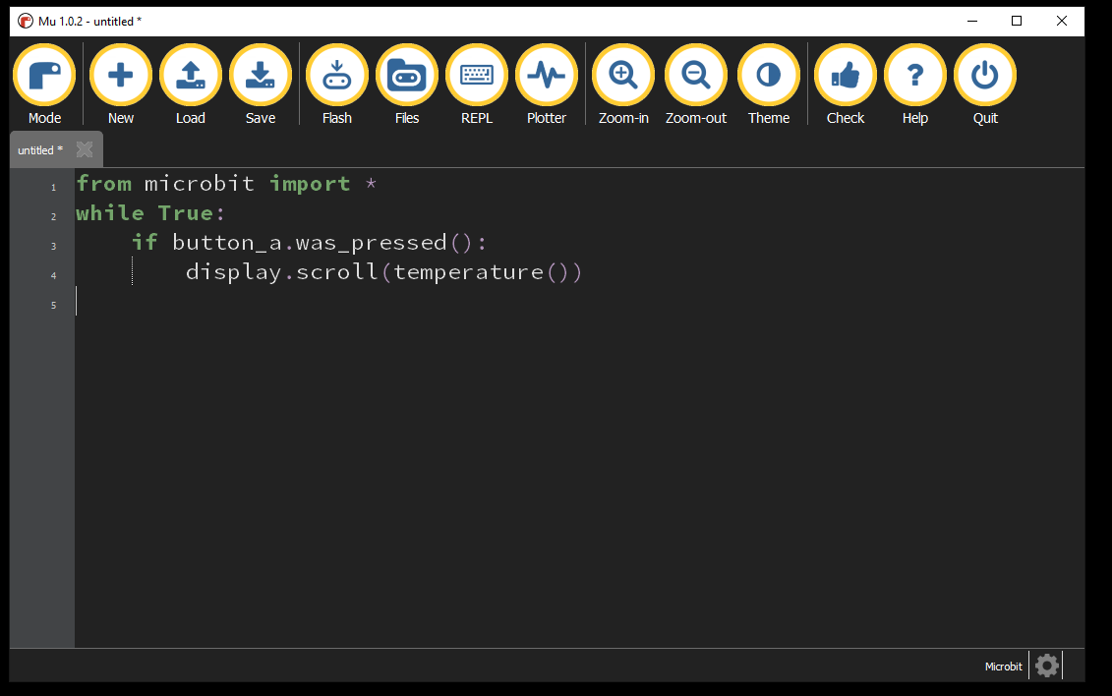
BBC micro:bit Mu Python Editor
Notes:
This is the editor that we suggest students use for editing their work. It has syntax checking and code-completion to make things a bit easier.
For online work in groups, we’ll use the bbc:microbit editor.

Slide 4
REPL
REPL pronounced “rep-l” stands for
READ
EVALUATE
PRINT
LOOP
The REPL is used to communicate like a command-line to the Python interpreter.
We use it as a short-cut to test code pieces quickly before we start writing a program.

Slide 5
Mu Editor REPL Access
Notes:
This is the editor that we suggest students use for editing their work. It has syntax checking and code-completion to make things a bit easier.
For online work in groups, we’ll use the bbc:microbit editor.

Slide 6
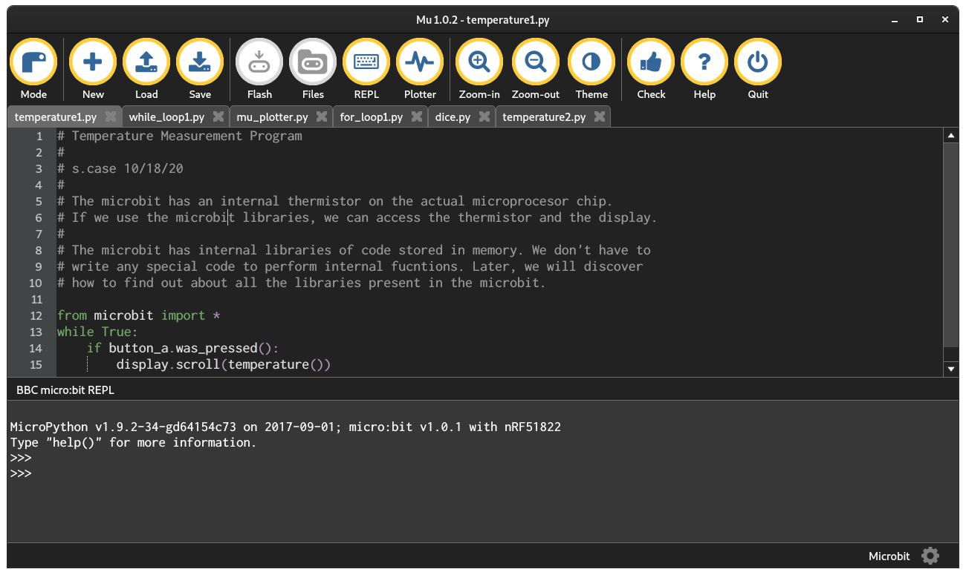
BBC micro:bit REPL is here >>>
Notes:
This is the editor that we suggest students use for editing their work. It has syntax checking and code-completion to make things a bit easier.
For online work in groups, we’ll use the bbc:microbit editor.

Slide 7
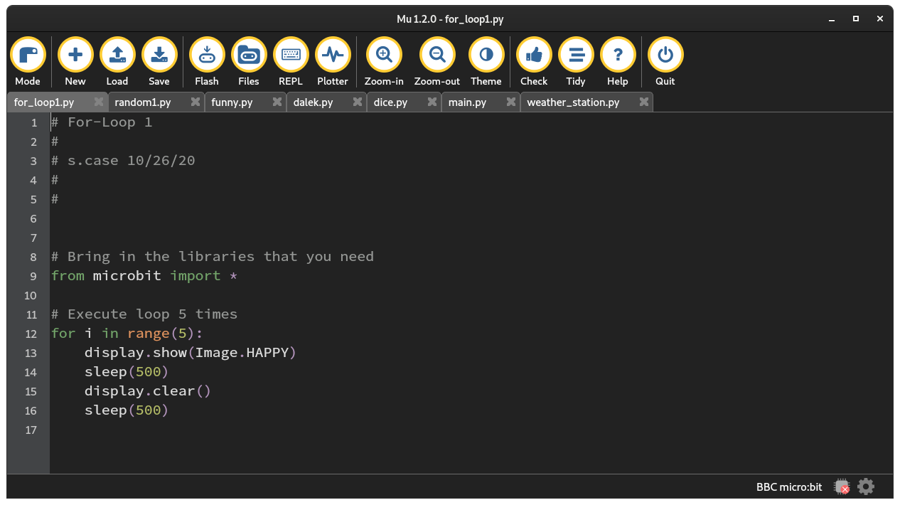
BBC micro:bit FLASH Program
Notes:
This is the editor that we suggest students use for editing their work. It has syntax checking and code-completion to make things a bit easier.
For online work in groups, we’ll use the bbc:microbit editor.

Slide 8
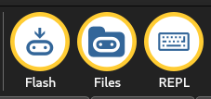
BBC micro:bit Get ready to FLASH
These buttons should be yellow.
Notes:
This is the editor that we suggest students use for editing their work. It has syntax checking and code-completion to make things a bit easier.
For online work in groups, we’ll use the bbc:microbit editor.

Slide 9
REPL
>>> help()
Welcome to MicroPython on the micro:bit!
Try these commands:
display.scroll('Hello')
running_time()
sleep(1000)
button_a.is_pressed()
What do these commands do? Can you improve them? HINT: use the up and down
arrow keys to get your command history. Press the TAB key to auto-complete
unfinished words (so 'di' becomes 'display' after you press TAB). These
tricks save a lot of typing and look cool!

Slide 10
REPL
Explore:
Type 'help(something)' to find out about it. Type 'dir(something)' to see what
it can do. Type 'dir()' to see what stuff is available. For goodness sake,
don't type 'import this'.
Control commands:
CTRL-C -- stop a running program
CTRL-D -- on a blank line, do a soft reset of the micro:bit
CTRL-E -- enter paste mode, turning off auto-indent
For a list of available modules, type help('modules')
For more information about Python, visit: http://python.org/
To find out about MicroPython, visit: http://micropython.org/
Python/micro:bit documentation is here: https://microbit-micropython.readthedocs.io/
>>>

Slide 11
Python Basics in the REPL- Variables
>>> i = 1
>>> print(i)
1
>>> j = 2.
>>> print(j)
2.0
>>> name = “Coco”
>>> print(name)
Coco
In this case, i is an integer. Think of integers as counting numbers.
In this case, j is an floating point number. Think of it as a number with a fractional part.
In this case, name is a string of collected characters.

Slide 12

Python Basics in the REPL- Libraries
Libraries are collections of programs written by others, that make things easier to duplicate.
A library can hold either one or many routines that we call by name inside them.
When we want to use a library, we need to “check it out” and bring it into our program.
Display
LED’s
Buttons

Slide 13
Python Basics in the REPL- Libraries
>>> from microbit import *
>>> display.scroll(“Hi you!”)
>>> import microbit
>>> microbit.display.scroll(“Hi you!”)
music
speach
microbit
display
>>> from microbit import display
>>> microbit.display.scroll(“Hi you!”)

Slide 14
What’s Happening?
>>> from microbit import *
>>> display.scroll(“Hi you!”)
STORAGE
(random)
(microbit)
(music)
CPU
>>> import microbit
>>> microbit.display.scroll(“Hi you!”)
RAM
Find out what’s inside of a library.
>>> dir()
>>> import music
>>> dir(music)

Slide 15
Python Basics in the REPL- Libraries
>>> i = 1
>>> print(i)
1
>>> j = 2.5
>>> print(j)
2.5
>>> dir()
>>> print(name)
>>> j = 2.5
>>> a = 1
>>> print(a)
In this case, i is an integer. Think of integers as counting numbers.
In this case, j is an floating point number. Think of it as a number with a fractional part.
In this case, name is a string of collected characters.

Slide 16
Anatomy of bbc:microbit python programs
# For-Loop 1
#
# s.case 10/26/20
#
#
# Bring in the libraries that you need
from microbit import *
# Execute loop 5 times
for i in range(5):
display.show(Image.HAPPY)
sleep(500)
display.clear()
sleep(500)
Comments
Libraries
Running program

Slide 17
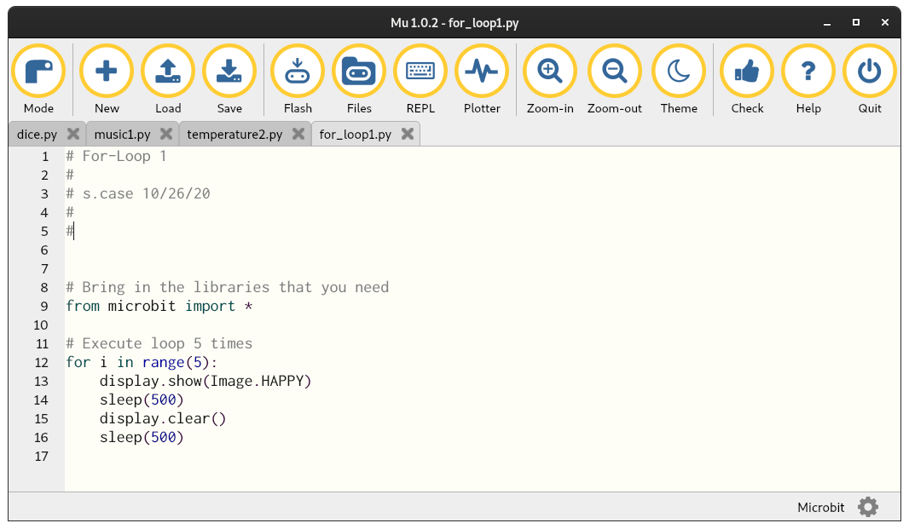
Mu Editor for Python
Controls
Programs on tabs
Editing area

Slide 18
Reference Material
Micropython Reference for the micro:bit
https://microbit-micropython.readthedocs.io/en/v1.0.1/index.html
Mu-Editor Installation:
https://codewith.mu/en/download
Seminar Slides:
Python Language:
https://www.w3schools.com/python/default.asp
https://www.python.org/ (advanced full reference for Python)
https://wiki.python.org/moin/BeginnersGuide (still pretty advanced)
Electronics Basics Vendors
Adafruit Industries: www.adafruit.com
Sparkfun electronics: www.sparkfun.com

